Slide 1










Pitch Deck
Welcome To SoulSync
Innovation • Creativity • Harmony

Slide 2



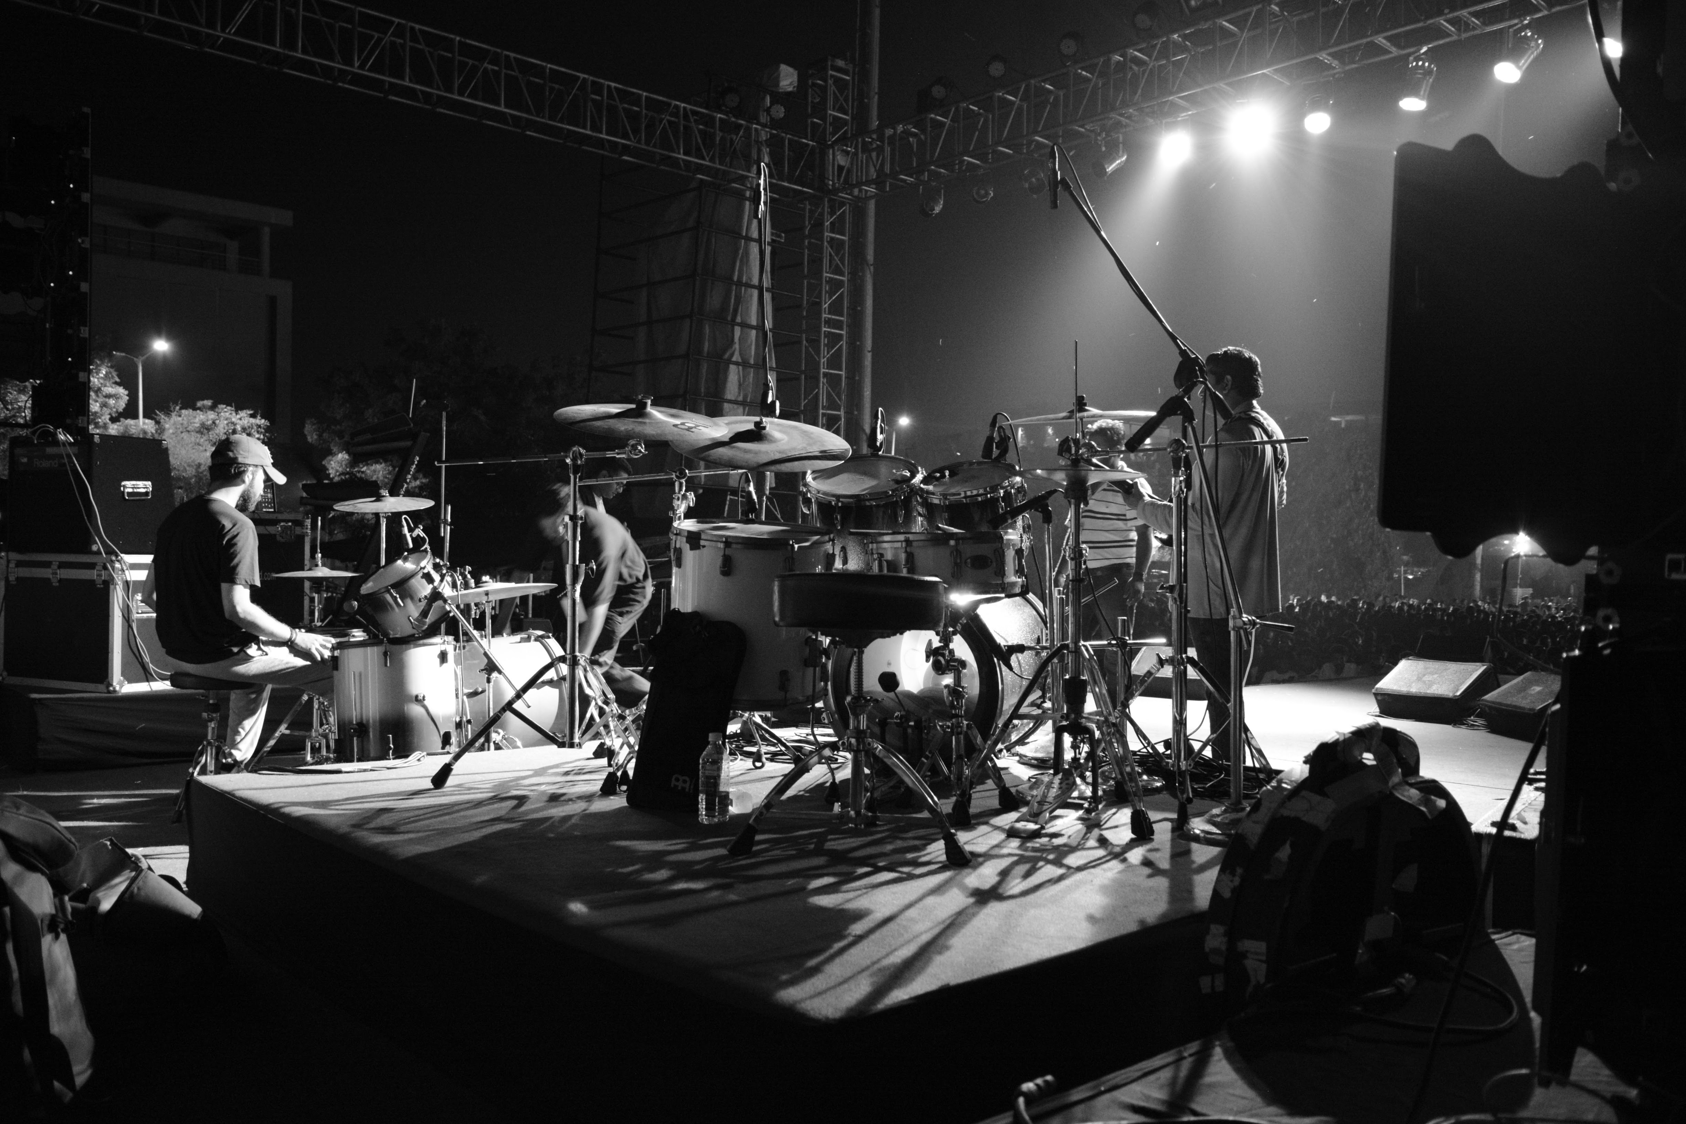
SoulSync is a beginner-friendly web app for mood-based song recommendations, built with HTML, CSS, and basic JavaScript.
It features a login page for user details and a main page with mood selections leading to YouTube-linked songs in multiple languages.
About SoulSync

Slide 3





Streamlined UI/UX
Demonstrate basic form validation and use localStorage for simple, two-page data transfer and a smooth user experience.
Dual-Condition Filtering
Implement core logic to filter data based on two simultaneous parameters: selected Mood and user-chosen Language.
Project Purpose
Aesthetic CSS Design
Apply modern CSS techniques (gradients, Flexbox) to create a beautiful, engaging, and easily maintainable User Interface.

Slide 4


Features
Dynamic Song Filtering 🎵
The system provides instantaneous, dual-condition filtering of song data based on both the selected Mood (e.g., Happy) and the chosen Language (English, Hindi, Bangla).
Output is presented as clickable hyperlinks to YouTube, ensuring immediate access to music.
Simple Client-Side Data Flow 💾
Utilizes HTML required attributes for basic form validation at login.
Employs localStorage in JavaScript to quickly transfer the user's name between the login page and the main page for a personalized welcome.

Slide 5

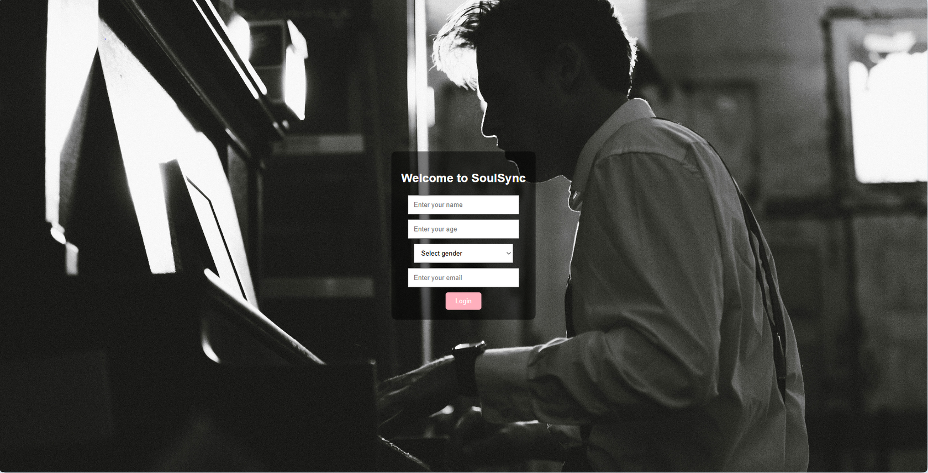

Project Demonstration

Slide 6

Discussion :
Development Problems & Solutions :
problem: Dual-Filtering Song List 🎭
The challenge was to display songs only if they matched both the selected Mood AND the chosen Language.
Solution: Conditional JavaScript Logic ✅
Mechanism: The filterSongs() function checks an OR condition: display song if Language is 'All' OR if the song's lang property matches the selection.
Result: Ensures an accurate and highly relevant song list for the user.

Slide 7
References :
Lab notes & Books
Youtube tutorials

Slide 8


CONCLUSION :
🏆 Project Conclusion :
SoulSync successfully delivers a simple, elegant, and functional web application using core HTML, CSS, and basic JavaScript principles. The project effectively demonstrates client-side concepts such as form validation, data persistence using localStorage, and dynamic content rendering via event handling and conditional filtering. This foundational architecture provides a user-friendly experience while proving proficiency in essential front-end development techniques.

Slide 9
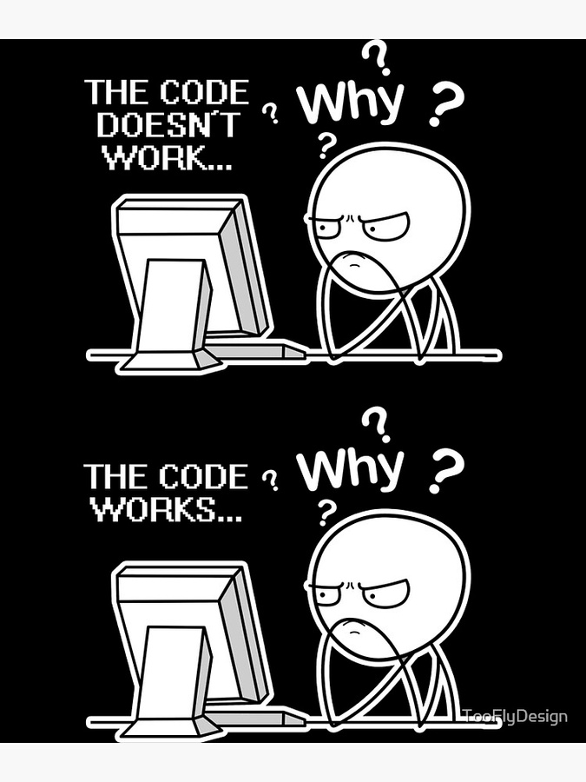
Contribution :
Name: Badhon Sharma Apurbo ID:04325105101051
Name: Aranya Earnest Nath
ID:04325105101075
Name: Md Aminul Islam
ID:04325105101076

Slide 10

Thank You

